Slide 1
Advanced Multithreading

Slide 2

Table of Content
Objective
Executor Service
Thread Pool Types
Callable and Future
Fork Join Framework
Atomic Operation
Latches
Next

Slide 3
Executor Framework
java.util.concurrent package was added in java 5. This package provides API for developing multithreaded applications in Java in an easier way.
java.util.concurrent.Executor is an object that executes Runnable threads.
Executor framework decouples the task of thread submission, executing its run() method ,thread scheduling, etc.
Next

Slide 4
Executor Framework (Continued)
Executor framework was introduced in Java 1.5 concurrency API.
Executor framework provides us high level replacement for working with threads directly.
Executor framework is capable of running asynchronous tasks and typically manage a pool of threads.
In Executor framework, programmer does not need to create the thread manually.
Next
Xoriant Solution Pvt. Ltd.

Slide 5
Executor Framework (Continued)
Executor framework has to be used as follows
Obtain the executor object via a factory method.
Factory is the standard name given for method that returns an object of a class instead of we creating the object explicitly.
java.util.concurrent.Executors class provides many static factory methods for this purpose.
Pass the target thread to its execute method
Next

Slide 6

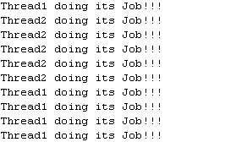
Executor Framework (Continued)
<<interface>>
Executor
<<interface>>
ExecutorService
Applying Executors
ExecutorService executor=java.util.concurrent.Executors.newFixedThreadPool(5);
executor.execute(new Thread1());
executor.execute(new Thread2());
Order of output is non-deterministic in a thread program
Returns a thread pool with fixed number of threads sharing an unbounded queue
Back
Next
Xoriant Solution Pvt. Ltd.

Slide 7
Applying Executors
ExecutorService executor = Executors.newFixedThreadPool(3);
Runnable runnable = new Runnable() {
public void run() {
System.out.println("Thread running");
}
};
executor.execute(runnable);
Next
Xoriant Solution Pvt. Ltd.

Slide 8
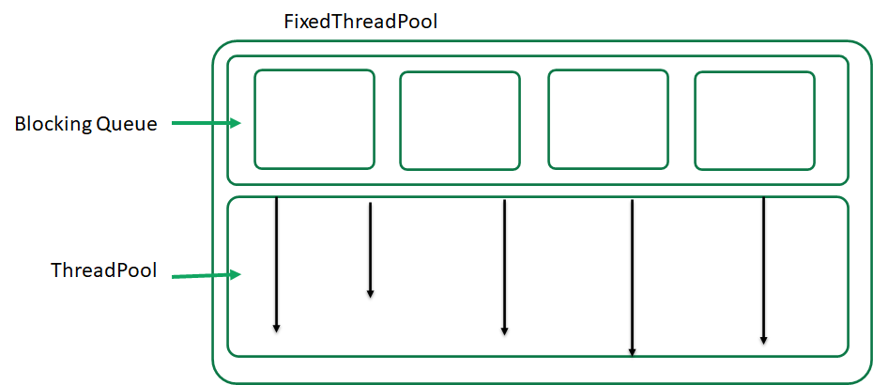
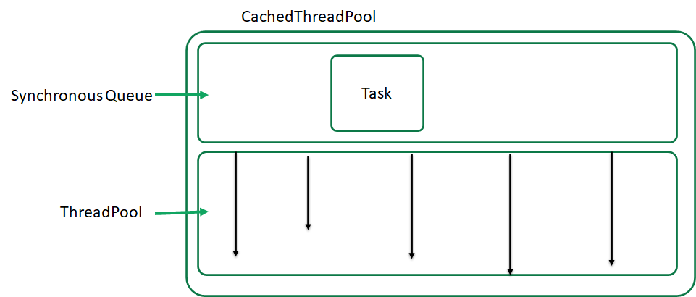
Executor Methods
newSingleThreadExecutor()
Creates an Executor that uses a single worker thread.
newFixedThreadPool(int nThreads)
Creates a thread pool that reuses a fixed number of threads.
newCachedThreadPool()
Creates a thread pool that creates new threads as needed.
newScheduledThreadPool()
Creates a thread pool that creates new threads as needed as well as the initial start delay time and periodic activity time for the thread can be set
Back
Xoriant Solution Pvt. Ltd.

Slide 9


Time for Case Study

Slide 10
Case Study-1
In our previous case study of prime number, how to implement the for making a thread return the result after execution?
Answer: is using Callable
Using Callable
Next
Xoriant Solution Pvt. Ltd.

Slide 11
Using Callable
ExecutorService executor = Executors.newFixedThreadPool(3);
Callable<Integer> callable = new Callable<Integer>(){
@Override
public Integer call() throws Exception {
System.out.println("Callable Thread started");
return 1;
}
};
Future<Integer> future = executor.submit(callable);
int result = future.get();
Back
Next
Xoriant Solution Pvt. Ltd.

Slide 12
Callables & Futures
In addition to Runnable, executor framework supports another kind of task named 'Callable.
Runnable returns void but Callable returns a value.
Callables are submitted to executors with submit() method instead of execute().
Callable return value can be accessed using a special object called 'Future’.
Back
Next
Xoriant Solution Pvt. Ltd.

Slide 13
Time for Case Study

Slide 14
Case Study-2
In our previous case study of prime number, how to implement the below
Accept array of numbers as input
Calculate the respective nth prime for each element of the array (where n is the value of that is stored in an array[i])
Sum all the resulted nth primes using divide and conquer algorithm
The solution to this is Fork & Join
Fork and Join
Next
Xoriant Solution Pvt. Ltd.

Slide 15
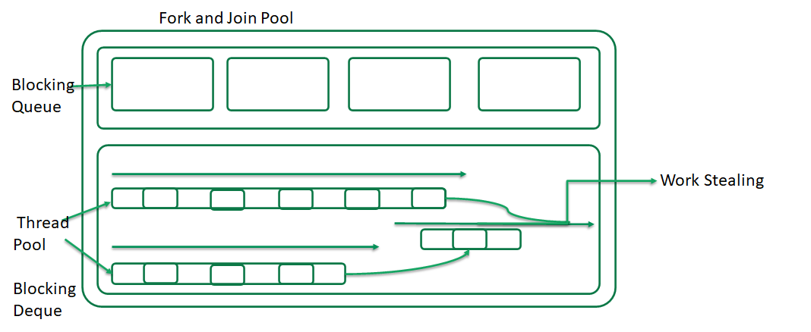
Fork & Join
Fork & Join framework is similar to MapReduce mechanism
It is implemented with divide and conquer algorithm
Diagram??
A special implementation of ExecutorService which conventional way of thread implementation will have the below issues:
Too many thread instances
Too resource intensive
Need for the light weight implementation
Fork & Join has
ForkJoinPool
ForJoinTask
Next
Xoriant Solution Pvt. Ltd.

Slide 16
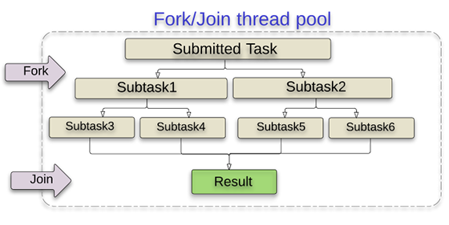
Steps to Implement Fork & Join
Create an implementation of ForkJoinTask
RecursiveAction (Task breakdown which are result less)
RecursiveTask (Task breakdown which are result oriented)
Get an instance of the ForkJoinPool
Submit an instance of the ForkJoinTask to the ForkJoinPool
Anatomy diagram
Back
Xoriant Solution Pvt. Ltd.

Slide 17
Automic Operations
public int getCount() {
return count++;
}
AtomicInteger count = new AutomicInteger();
public int getCount() {
return count.incrementAndGet();
}
Next
Xoriant Solution Pvt. Ltd.

Slide 18
Latches
A latch is a synchronizer that can delay the progress of threads until it reaches its terminal state
A latch acts as a gate: until the latch reaches the terminal state the gate is closed and no thread can pass, and in the terminal state the gate opens, allowing all threads to pass.
Once the latch reaches the terminal state, it can not change state again, so it remains open forever
Next

